Slide 1
Italian Restaurants
in Toronto

Slide 2
Introduction
Toronto is well known for its great food. The objective of this project is to use Foursquare location data and regional clustering of venue information to determine what might be the best neighborhoods in Toronto to open a Italian restaurant.
Pizza and Pasta are one of the most bought dishes in Toronto originating from Italy. Toronto being the fourth largest home to Italians with a population over 500k, there are huge opportunities and favorable target audience to open a new Italian restaurant.
Through this project we will find the most suitable location for an entrepreneur to open a new Italian restaurant in Toronto, Canada. It will also people who want to shift to other neighborhoods and prefer Italian food as their daily prioritized needs

Slide 3

Data Overview
The data required to carry out the analysis will be a combination of CSV file containing data information collected from multiple sources.They are mentioned as follows:-
The list of postal codes with their respective borough and neighbourhoods were collected from Wikipedia
The corresponding geographical location were obtained from geocoder package and the given link(https://cocl.us/Geospatial_data).
At last, The venues present in each neighbourhood which consisted of italian restaurants and pizza places were fetched from Foursquare API.Their geopgraphical locations were also included in it.

Slide 4
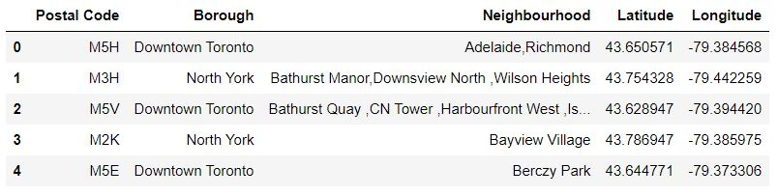
Methodology
First we will need extract data from all the data sources.
Then we’ll merge all data from different sources to create a dataframe that is used for our purpose to achieve the task

Slide 5
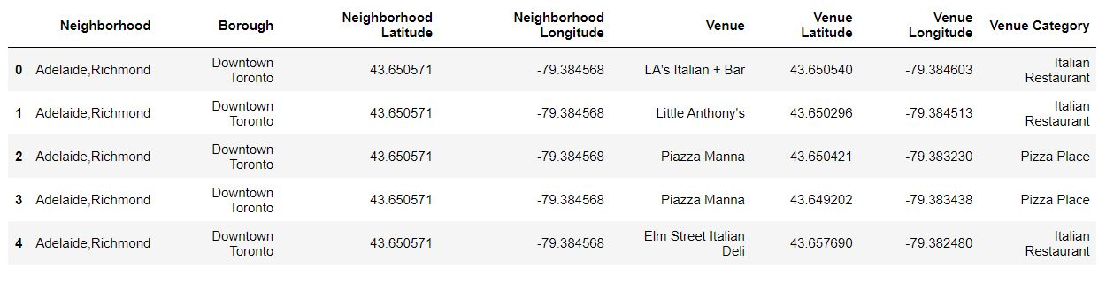
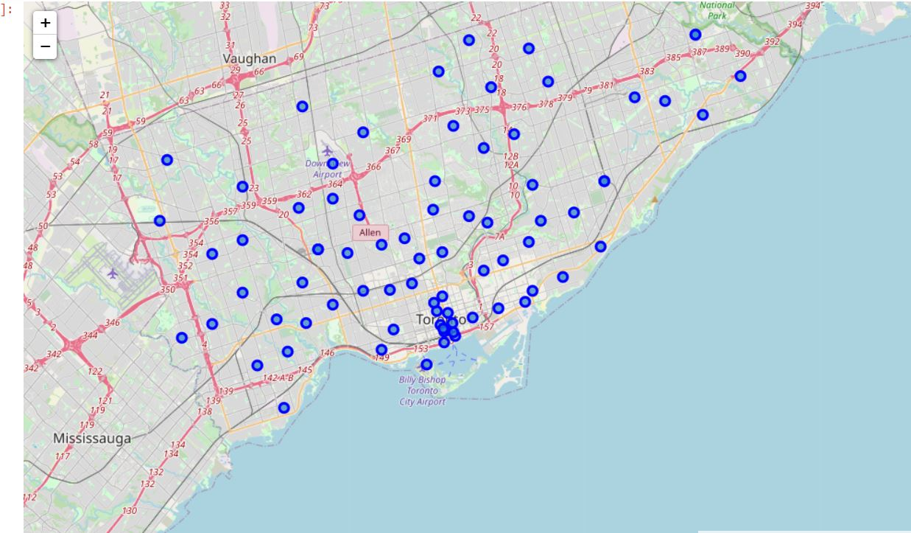

Slide 6
Analysis
After all the relevant data was collected ,Grouping of data was done on venue dataframe to know the number of italian places present in each neighborhood and stored in a dataframe.
The other analysis performed was grouping venues based on Boroughs in which they were present.
Pie chart representing proportion of italian restaurants in percentage for all boroughs in toronto city.

Slide 7
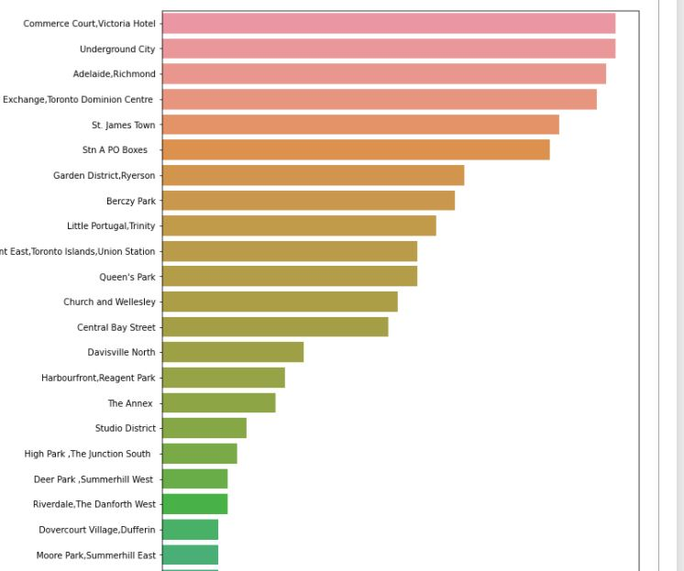
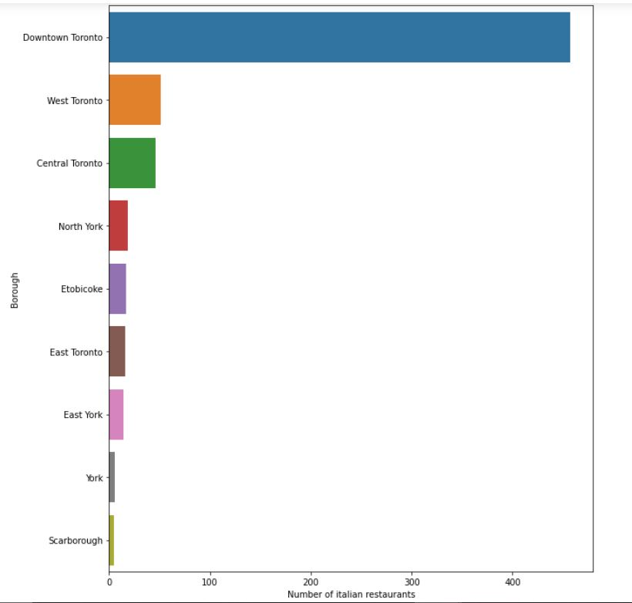
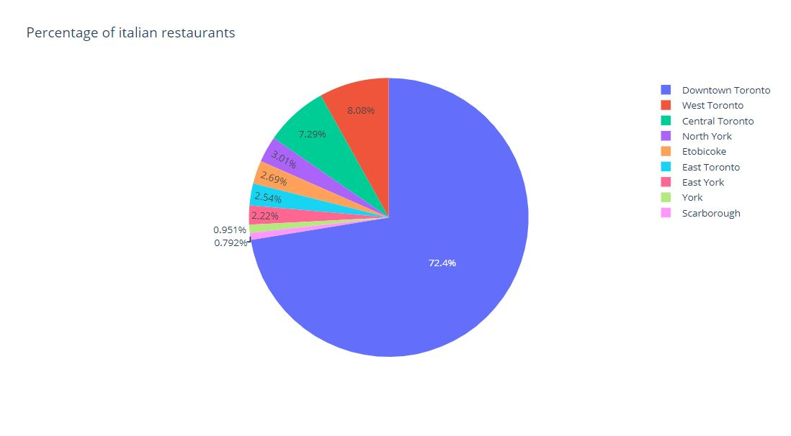

Slide 8
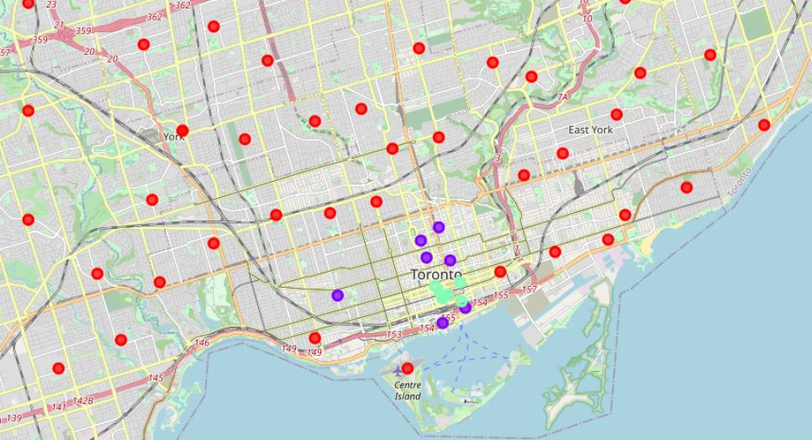

Slide 9
Discussion
Most of italian restaurants are present in cluster 3(green) as those neighborhoods have a high number of variety for italian cuisines and an average of 47 different places to go per neighborhood. So we can suggest neighborhoods like Adelaide, Richmond, underground city etc present in Downtown to people who prefer italian food on a regular basis and are fond of pizzas.
As per business perspective, business officials and entrepreneurs can select a wide variety of neighborhoods from north york,Scarborough ,Etobichoke belonging to cluster 1(red) to open an italian restaurant as these have very few number of places.So there is a high chance for restaurant to be a success and satisfying people needs in that area as they have very few options to enjoy a italian delicacy.
Cluster 2(purple) contains a moderate amount of italian places at an average of 27 per neighborhood.It is a moderately competetive region and one can think of starting a new italian restaurant if they are confident enough about their dishes and menu.

Slide 10
Conclusion
In conclusion, to end off this project, we had an opportunity on a business problem, and it was tackled in way that it was similar to how a genuine data scientist would do.
We have utilized Foursquare API to investigate the settings in neighborhoods of Toronto, get great measure of data from Wikipedia which we scraped with the Beautifulsoup Web scraping Library.
We also visualized utilizing different plots present in seaborn ,matplotlib libraries and created maps tagged with neighborhoods of city Toronto.
Ideally, the task performed in this capstone project acts as an initial direction to tackle more complex real-life problems using data-science.

